Slide 1
Week 6
Lecture on Ethics and business entity
Mid Tri Test
Tutorial

Slide 2
Week 6: Ethics & Business Entities
Brief lecture on ethics and entity. This should assist the completion of the Assignment in Week 8

Slide 3
Role of Ethics in Accounting and Business
Business Ethics
are moral principles that guide the conduct (behaviour) of individuals.
Higher level of behaviour than required by Law
Unfortunately, business managers and accountants sometimes behave in an unethical manner. Many of the managers of the companies engaged in accounting or business fraud. These
ethical violations led to fines, job losses, and lawsuits. In some cases, managers were criminally prosecuted, convicted, and sent to prison.

Slide 4
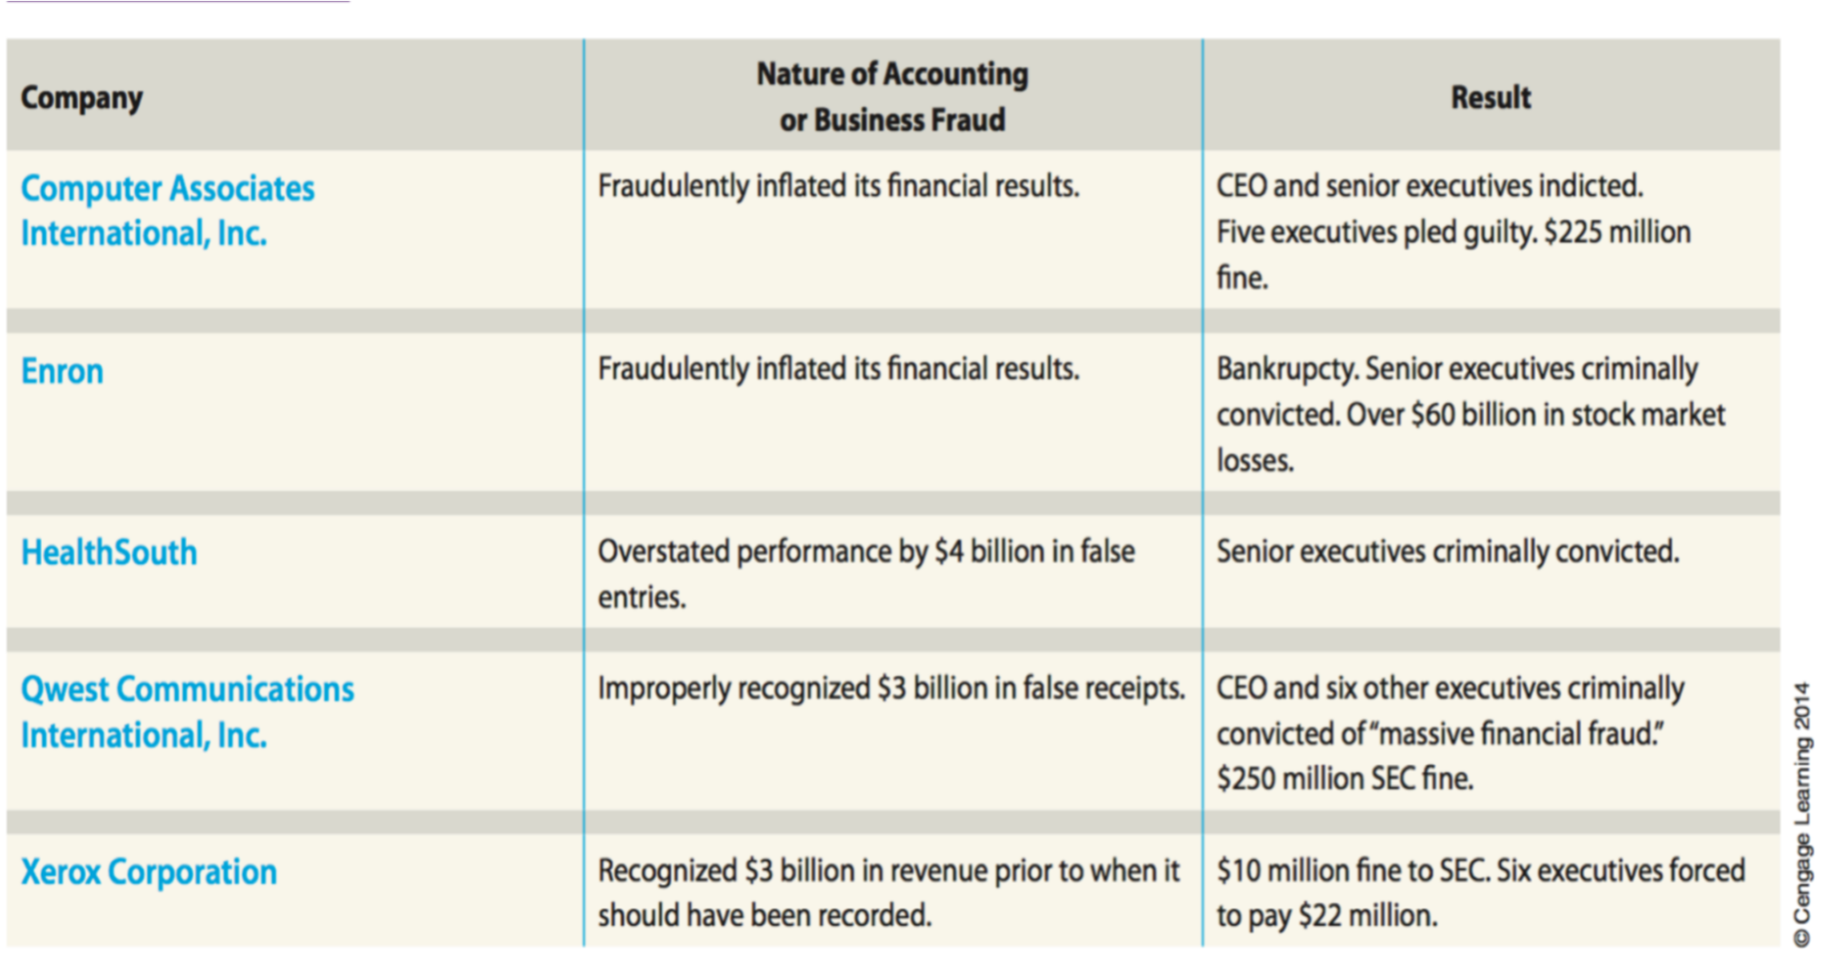

Slide 5
2 What went wrong in these examples?
Failure of Individual Character.
An ethical manager and accountant is honest and fair. However, managers and accountants often face pressures from supervisors to meet company and investor expectations.
Culture of Greed and Ethical Indifference.
By their behaviour and attitude, senior managers created a culture of greed and indifference to the truth. This negative culture can affect the reputation of the business and financial loss.

Slide 6
3 Ethics and Governance
Consumers demand organisation act in an ethical manner
Corporate Social Responsivity CSR requires managers to act ethically in operating their business.
Triple bottom line
Social
Environmental
Financial

Slide 7
6 Principals of professional conduct
Act in the public interest (eg car air bag recall)
Integrity- honest
Objectivity – no conflict of interest
Independence –
Confidentiality – protect customers privacy
Technical or professional competence – can do the job you are tasked with
Ethical behaviour – should meet the expectations of the profession you are part of

Slide 8
7 What does ethical behaviour mean?
(source: HEM, 9E p23)
Ethical conduct can be considered important to a business’ long-term survival because:
It attracts a regular and stable client base;
Unethical (illegal) conduct may prove to be costly;
It may attract shareholders and/or consumers in that they trust you to manage the money successfully and/or provide a quality service; and
Unethical conduct can lead to government intervention and even closure of the business.

Slide 9
10 Ethical Case Study
Justin works as an accountant for Dodgy. His boss, Mr Greedy is part of the management team that receive a bonus depending on the profitability of the business. If Dodgy makes $10 million in profit, the owner will pay each member of the management team a bonus of $50,000.
At the end of June, it appears that Dodgy will only make a profit of $9.9 million. Mr Greedy instructed Justin to find ways of maximising the profit for the year. He suggested that some of the expenses incurred this year should not be recorded until next year.
Who are the stakeholders in this situation?
What are the ethical issues?
What would you do if you were Justin?

Slide 10
11 Business Entity Concept Sole trader
A sole trader is an individual who conducts and owns their business. They begin by investing capital or equity into the business.
They will have full responsibility and control over the business operations and activities.
Legally, the owner is personally liable for all the business debts.
For accounting purposes, a sole trader is a distinct entity, separate from the owner. This means that the business records should not include the proprietor’s personal finances.
Sole traders tend to be individual providers of services or small retail stores - accountants, doctors who set up their own practice, a freelance photographer.

Slide 11
12 Partnership
A partnership has two or more parties as co-owners, and each owner is a partner.
Many professional service firms (law, accounting, engineering, medical practitioners, architecture) operate as partnerships.
The partnership is treated as a separate entity for accounting purposes but is not recognised as a separate legal entity.
Each partner pays tax according to that partner’s individual or corporate rate.
partnerships have unlimited liability. Each partner may conduct business in the name of the entity and can make agreements that legally bind all partners without limit for the partnership’s debts. Partnerships are therefore quite risky.

Slide 12
13 Company
A company is a business owned by shareholders who hold equity, representing shares of ownership in the company.
A company is recognised as a separate legal entity. The assets and liabilities belong to the company and shareholders have no personal obligation for the company’s debts.
Shareholders elect the board of directors, who then make decisions for the daily operations of the business.
is more appropriate for entities requiring larger capital contribution, which have a large number of operating costs and greater number of employees.
The disadvantages include higher set up and on-going costs.

Slide 13
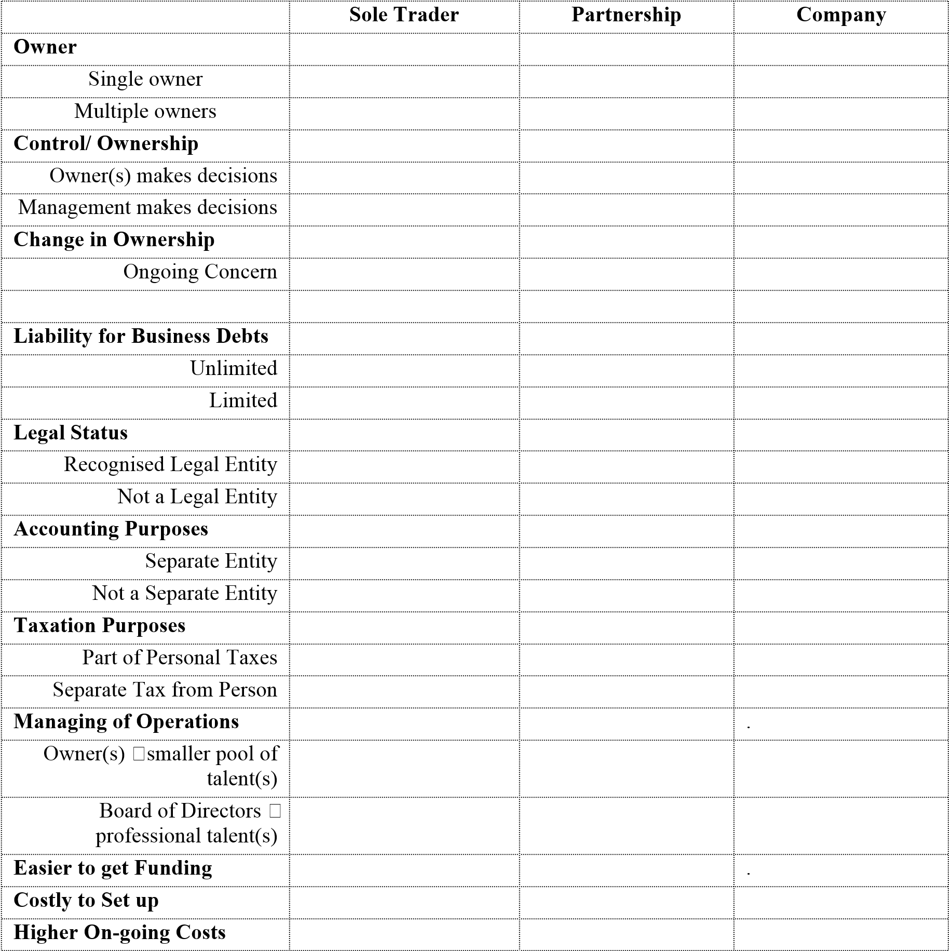
14 Summary Business Entities

Slide 14
15 Choose a suitable business structure 2 minute Case study – Short and sharp
CASE STUDY 1:
Frank bought a motorcycle and uses it to start a small delivery business. He prefers the freedom of working on his own and does not want to share any business profit.
CASE STUDY 2:
Frank is doing well and after 6 months the number of clients has increased. To grow the business Frank decides to approach a good friend called Eric whom he knows owns a van. Eric is interested in being involved in Frank’s business so they agree to the following arrangement:
Frank takes care of the daily operations that involve taking orders from clients and keeping proper business records.
Eric will be responsible for all delivery to clients.
They decide to share the profits equally.

Slide 15
CASE STUDY 3:
After 2 years, Frank and Eric require two more vans and will now need to hire more people to help with the business. Neither Frank nor Eric can financially afford to invest more into the expanding business. The operating costs to run the business and hire more employees are starting to increase. They are concerned about the risk involved if they continue to expand under their current business partnership.
Do you recommend any changes to the current business structure? Why/why not?

Slide 16
Tutorial Week 6
Mid Trimester test
Tutorial questions
Introduce Assignment due Week 8
Update glossary

